Slide 1
openCV project
Natallia Urieva
Chris Perez

Slide 2
objective
Our goal for the capstone course is to program or synthesize an already existing program to use the Microsoft lifecam hd-3000 camera to detect and follow a red circle that is placed in front of it. After detecting the red circle the camera should note the location of the circle and adjust itself horizontally using a Dynamixel servo motor to have the circle in the center of the screen.
lead programmer/project manager/research: Natalia Urieff
assistant programmer/research/hardware: Chris Perez

Slide 3
hardware
Computer: intel NUC # 5i7RYH
Ubuntu version: 14.04 LTS
Camera: Microsoft lifeCam hd-3000
Servo Motor: Dynamixel MX-28
PC interface : Robotis USB2Dynamixel
Power Supply board : Robotis RS485
Power supply for Robotis RS485: Agilent: 12v, 1A

Slide 4
Software
Ubuntu version: 14.04 LTS
OpenCV version: 3.0.0
Servo motor library: /home/capstone/Desktop/pythonOpenCV/lib_robotis.pyc
IDE used – none
Command line to compile cpp code:
g++ `pkg-config –cflags opencv` -std=c++0x newLifeCamDetection.cpp `pkg-config --libs opencv` -o newLifeCamDetection
Command line to run the application:
./newLifeCamDetection

Slide 5
Set up schematic
Keyboard
Monitor
Mouse
NUC
Robotis
USB2Dynamixel
Webcam
Microsoft
Lifecam hd-3000
Power Supply
12v, 1A
Robotis
RS485
Dynamixel
MX-28

Slide 6
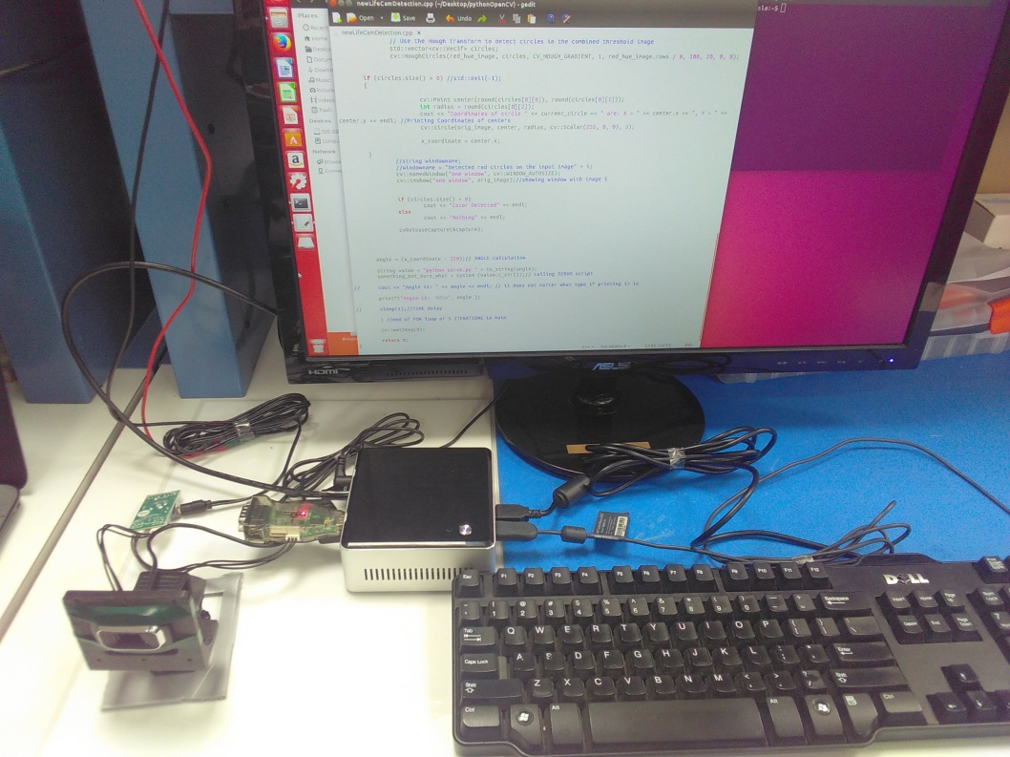
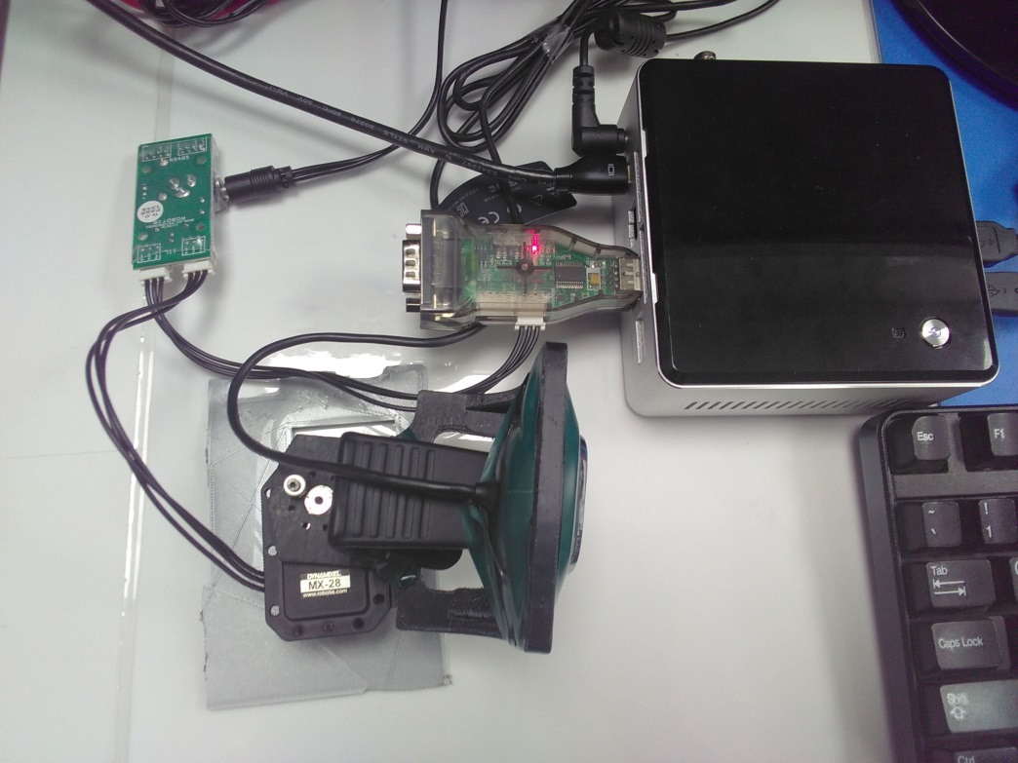
Actual setup

Slide 7
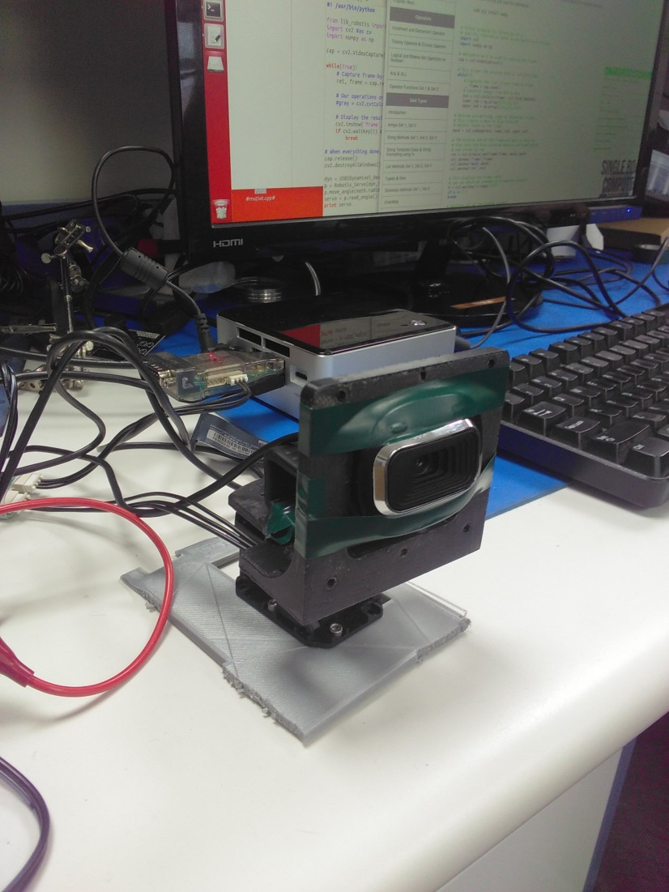
Microsoft lifecam mounted on Dynamixel Mx-28

Slide 8
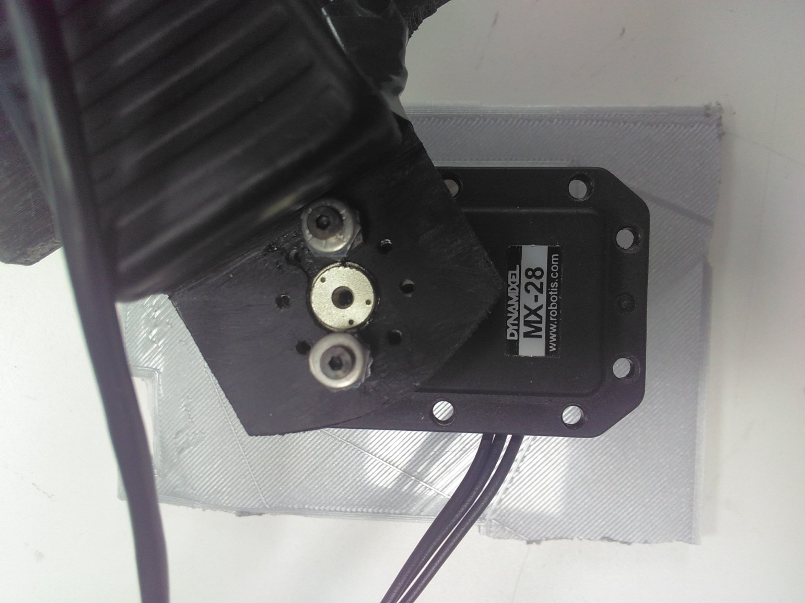
Dynamixel MX-28

Slide 9
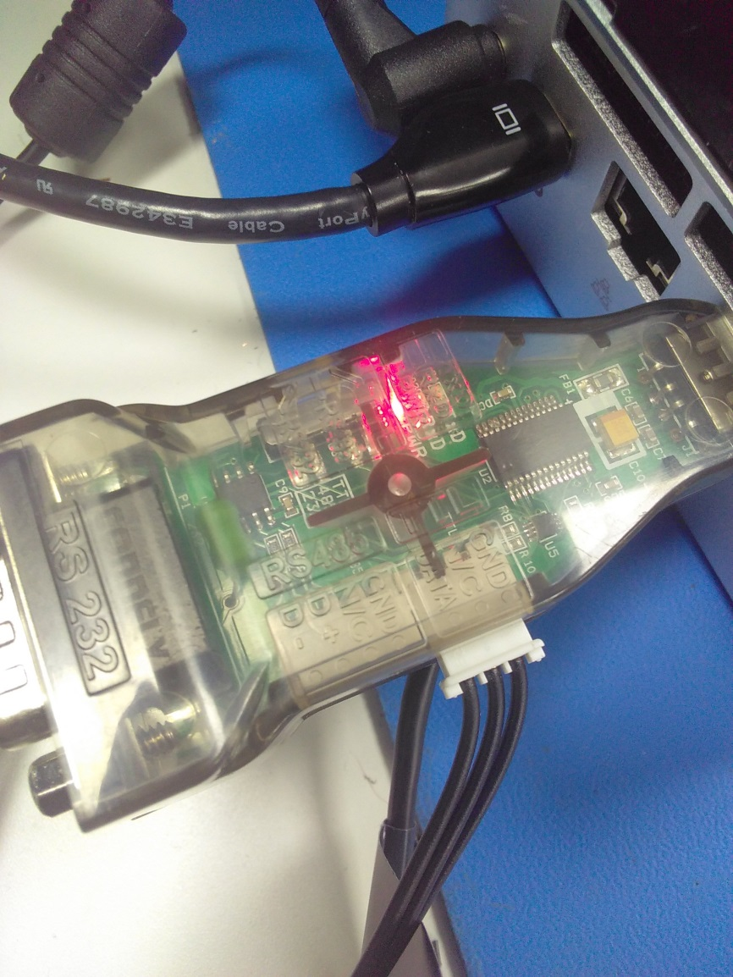
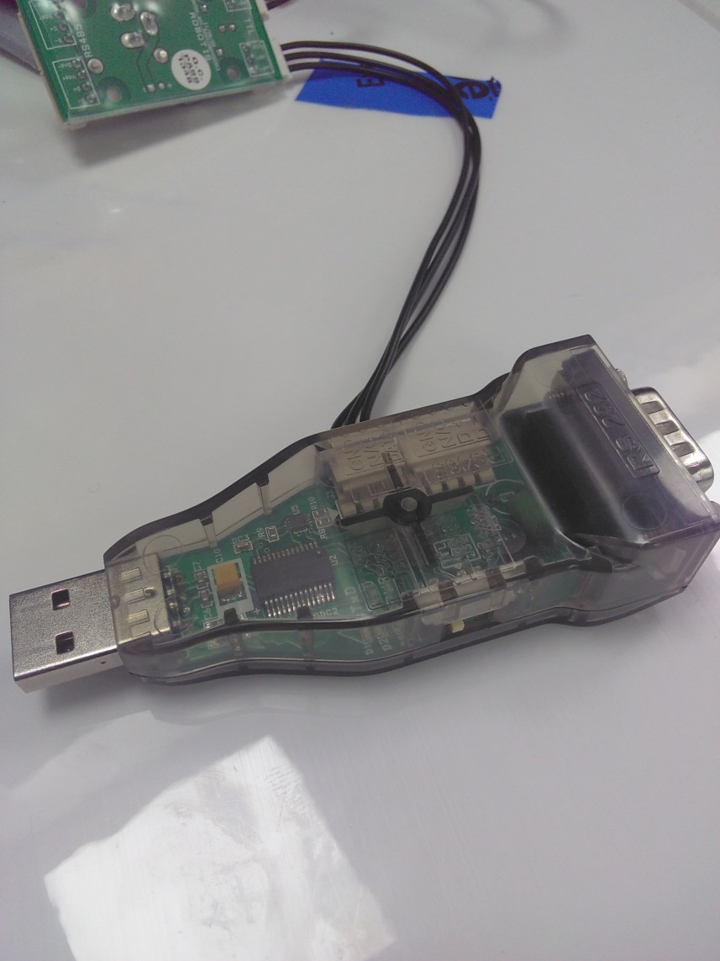
Robotis USB2Dynamixel

Slide 10
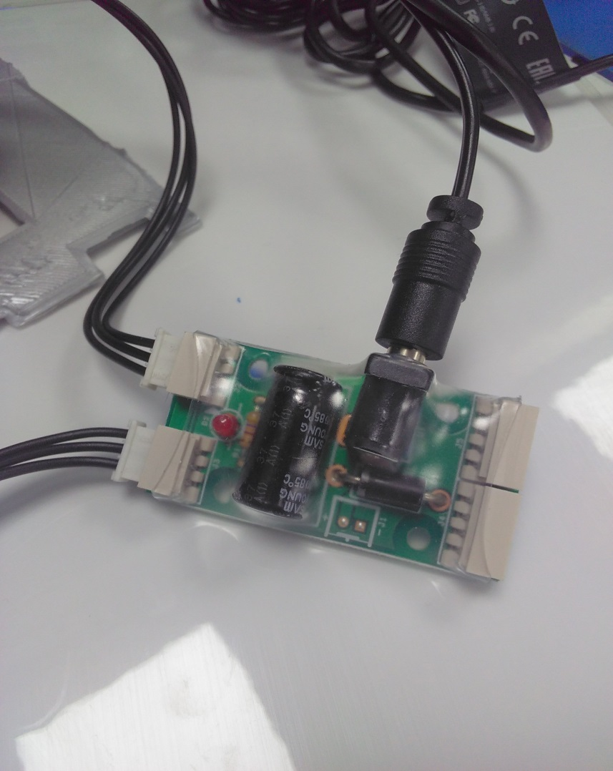
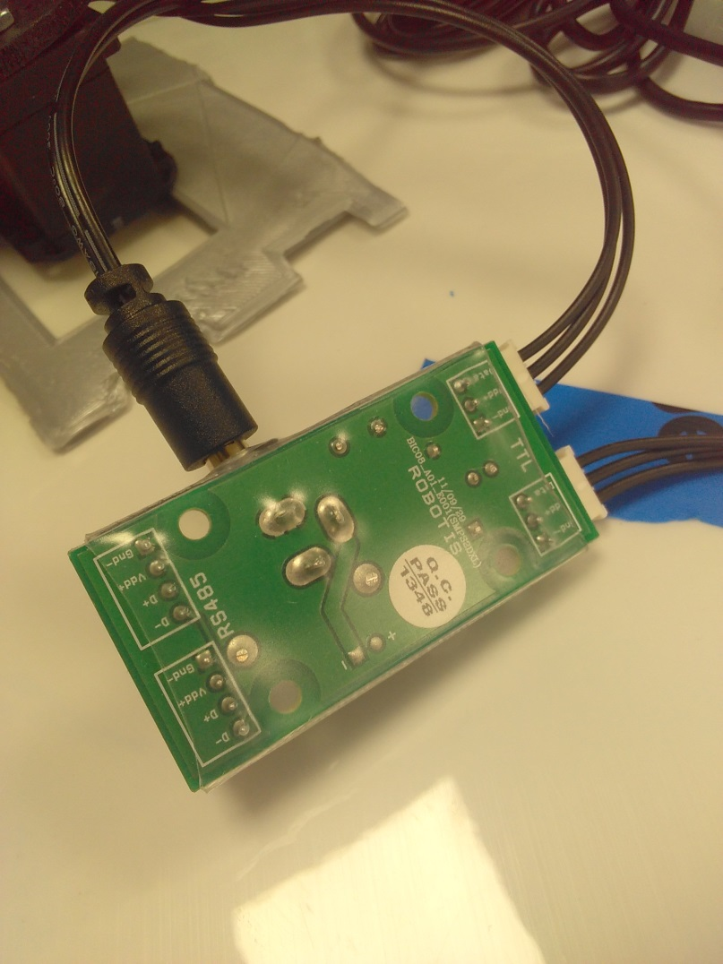
Robotis RS485

Slide 11
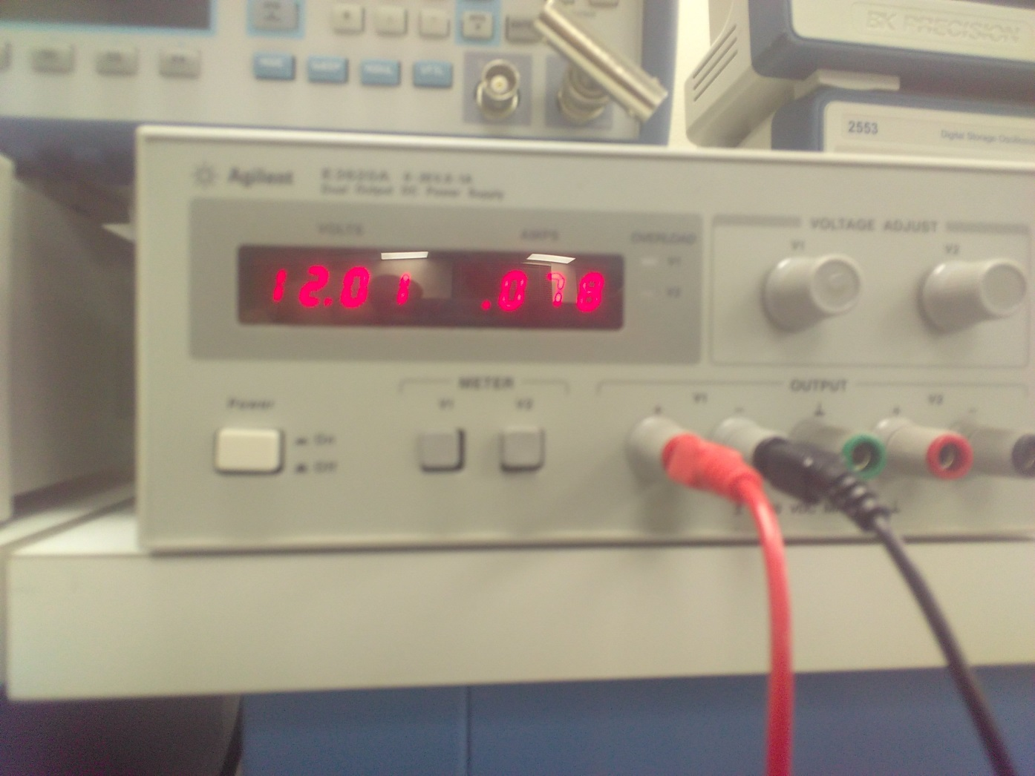
Power supply to Dynamixel 12v, 1A

Slide 12
Software libraries
lib_robotis.pyc (dynamixel library)
openCV (library for object detection on pixel images)

Slide 13
#include <opencv2/opencv.hpp>
#include <vector>
#include <cv.h>
#include <highgui.h>
#include <opencv2/opencv.hpp>
#include <vector>
#include <map>
#include <highgui.h>
#include <stdio.h> /* printf */
#include <stdlib.h> /* system, NULL, EXIT_FAILURE */
#include <iomanip>
#include <string>
#include <iostream>
#include <sstream>
//#include <unistd.h> //for "sleep" function, not used
using namespace std;
using namespace cv;

Slide 14
using namespace std;
using namespace cv;
int main()
{
int angle = 0;
while (true) // DETECTION LOOP
{
int something_not_sure_what, x_coordinate;
//creating capturing object (opening camera)
CvCapture* capture = cvCaptureFromCAM(0);
if (!capture) {
fprintf(stderr, "ERROR: capture is NULL \n");
getchar();
return -1;
}
// Reading image:
//1) creating "IplImage" object
IplImage* frame = cvQueryFrame(capture);
if (!frame) {
fprintf(stderr, "ERROR: frame is null...\n");
getchar();
break;
}
//2) using "IplImage" object to save image to file
cvSaveImage("test.jpg", frame);

Slide 15
//STARTING DETECTION:
//1) reading image from file into Mat object
cv::Mat bgr_image = cv::imread("test.jpg", cv::IMREAD_COLOR);
cv::Mat orig_image = bgr_image.clone();
// BLUR, nesessary for avoiding multiple detections of same object
cv::medianBlur(bgr_image, bgr_image, 3);
// Convert input image to HSV
cv::Mat hsv_image;
cv::cvtColor(bgr_image, hsv_image, cv::COLOR_BGR2HSV);
// Threshold the HSV image, keep only the red pixels
cv::Mat lower_red_hue_range;
cv::Mat upper_red_hue_range;
cv::inRange(hsv_image, cv::Scalar(0, 150, 150), cv::Scalar(10, 255, 255), lower_red_hue_range);
cv::inRange(hsv_image, cv::Scalar(170, 150, 150), cv::Scalar(180, 255, 255), upper_red_hue_range);
// Combine the above two images
cv::Mat red_hue_image;
cv::addWeighted(lower_red_hue_range, 1.0, upper_red_hue_range, 1.0, 0.0, red_hue_image);
cv::GaussianBlur(red_hue_image, red_hue_image, cv::Size(9, 9), 2, 2);
// Use the Hough transform to detect circles in the combined threshold image
std::vector<cv::Vec3f> circles;
cv::HoughCircles(red_hue_image, circles, CV_HOUGH_GRADIENT, 1, red_hue_image.rows / 8, 100, 20, 0, 0);

Slide 16
if (circles.size() > 0) //IF something detected:
{
cv::Point center(round(circles[0][0]), round(circles[0][1]));
int radius = round(circles[0][2]);
//Printing Coordinates of centers
cout << "Coordinates of circle are: X = " << center.x << ", Y = " << center.y << endl;
cv::circle(orig_image, center, radius, cv::Scalar(255, 0, 0), 5);
x_coordinate = center.x;
cout << "x_coordinate: " << center.x << endl;
//determine direction (left or right) and
if(x_coordinate > 380)//object is in the right
{
angle = angle + x_coordinate/100; //move left
// calling SERVO script
string value = "python servo.py " + to_string(angle);
something_not_sure_what = system (value.c_str());
}
if (x_coordinate < 280)//object is in the left
{
angle = angle - x_coordinate/100; // move right
// calling SERVO script
string value = "python servo.py " + to_string(angle);
something_not_sure_what = system (value.c_str());
}
//otherwise, do not move

Slide 17
}// END of "SOMETHING DETECTED" condition
// showing windows with images, removed in the final version
//string windowname;
//windowname = "Detected red circles on the input image";
//cv::namedWindow(windowname, cv::WINDOW_AUTOSIZE);
//cv::imshow(windowname, orig_image);//showing window with image
if (circles.size() > 0)
cout << "Color Detected" << endl;
else
cout << "Nothing" << endl;
cvReleaseCapture(&capture); //stop capturing
printf("Angle is: %d\n", angle );
// sleep(1);//TIME delay, not used
} //end of DETECTION LOOP
cv::waitKey(0);
return 0;
}

Slide 18
Python code to move servo
#! /usr/bin/python
from lib_robotis import *
import cv2 #as cv
import numpy as np
import time
dyn = USB2Dynamixel_Device('/dev/ttyUSB0')
p = Robotis_Servo(dyn,1,series="MX")
print sys.argv[1]
p.move_angle(math.radians(float(sys.argv[1]))/-600)
servo = p.read_angle()
print servo
#time.sleep(1)

Slide 19
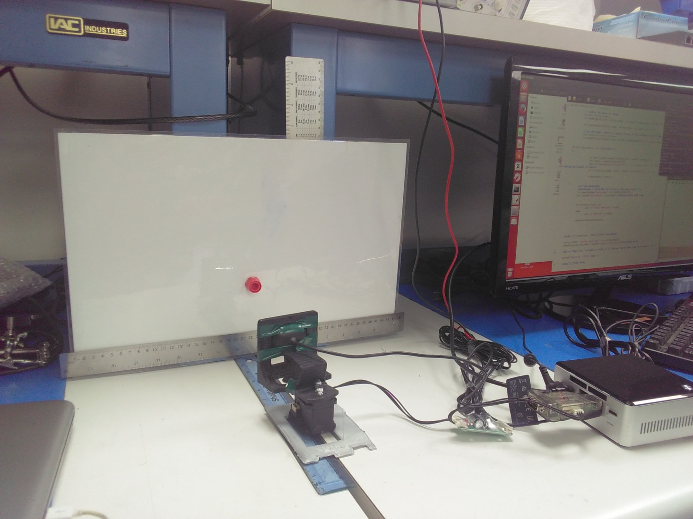
Calibrating servo angles

Slide 20
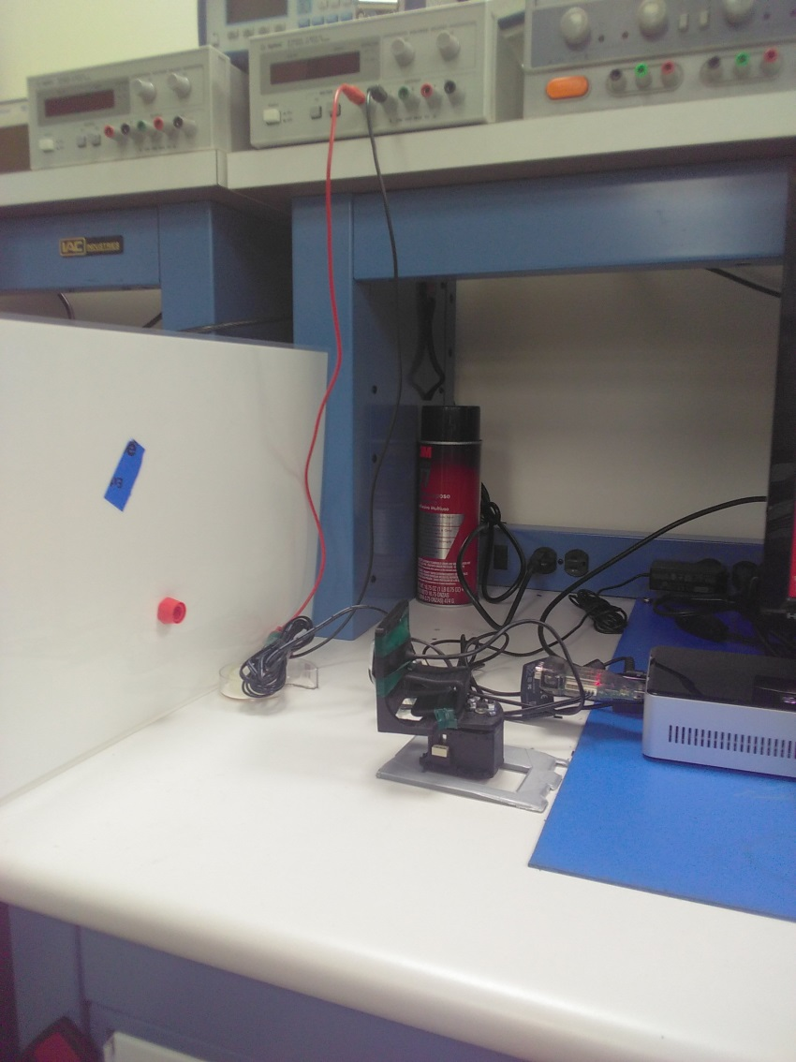
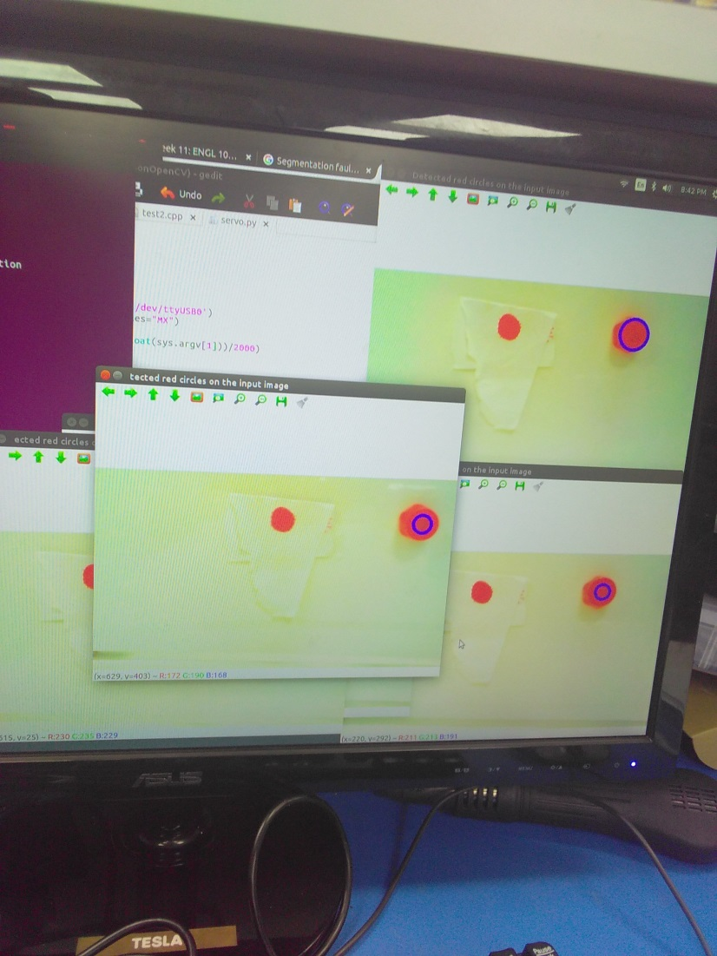
Trial run

